Slide 1

Module 12
Binary Files
I/O Streams

Slide 2
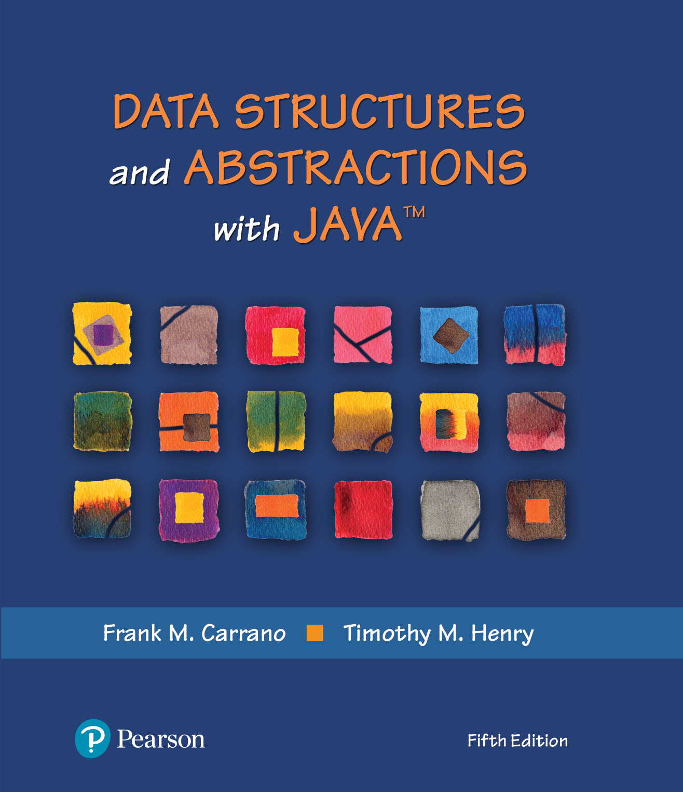
Data Structures and Abstractions with Java™
5th Edition
Module 17 – Advanced I/O and Object Streams
For additional info:
Supplemental 2 (online)

Slide 3
Module 17
Main topics:
Readers, Writers and Streams
Binary Input and Output
Random Access
Object Streams
Serialization
Serializing a Binary Tree

Slide 4
Text and Binary Formats
Two ways to store data:
Text format
Binary format

Slide 5
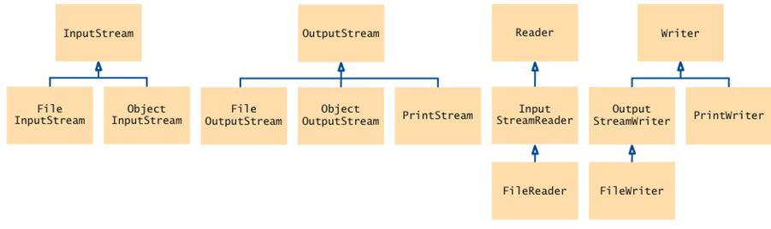
Classes for Input/Output
Binary files
Text files

Slide 6
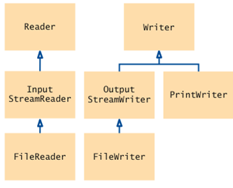
Text Format
Human-readable form
Sequence of characters
Integer 12,345 stored as characters '1' '2' '3' '4' '5'
Use Reader and Writer and their subclasses to process input and output
Reader and Writer classes are responsible for converting between bytes and characters

Slide 7
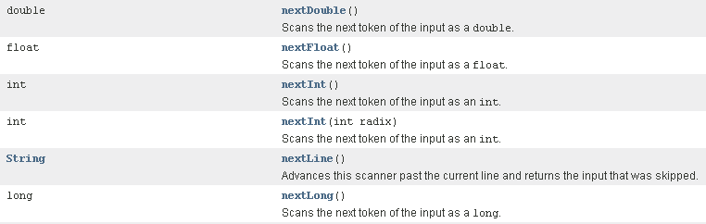
Text Format
To read:
FileReader reader = new FileReader("input.txt");
When constructing a Scanner from a File object, the Scanner automatically constructs a FileReader
Scanner scan = new Scanner(“input.txt”);
Some methods of the Scanner class that “convert” between bytes and characters

Slide 8
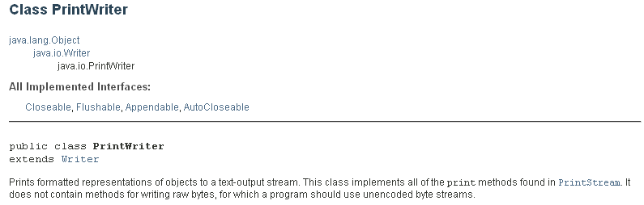
Text Format
To write:
FileWriter writer = new FileWriter("output.txt");
PrintWriter out = new PrintWriter("output.txt");

Slide 9

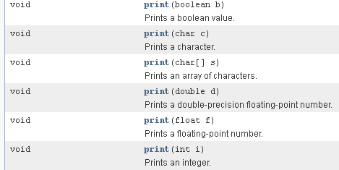
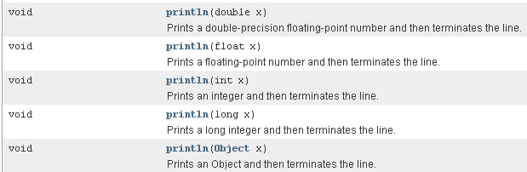
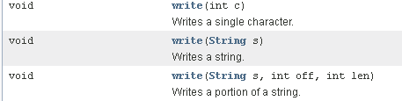

Slide 10
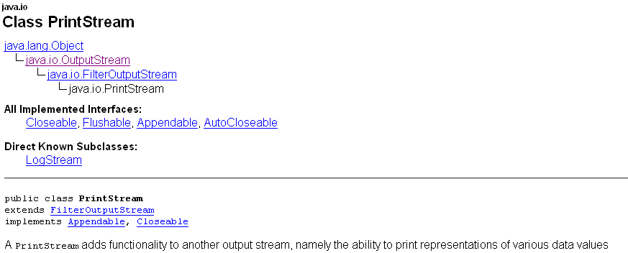
Text Format
System.out is a PrintStream object

Slide 11

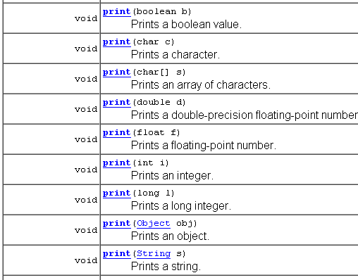

Slide 12
Binary Format
Data items are represented in bytes
Integer 12,345 stored as a sequence of four bytes
0 0 48 57
Use InputStream and OutputStream and their subclasses
More compact and more efficient

Slide 13
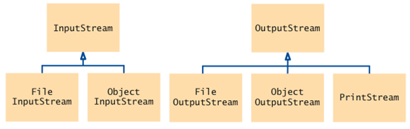
InputStream and OutputStream Classes
InputStream and OutputStream classes are responsible for input and output of bytes

Slide 14
Binary Format
To read:
FileInputStream inputStream =
new FileInputStream("input.bin");
Use read method of InputStream class to read a single byte
returns the next byte as an int
or the integer -1 at end of file
InputStream in = . . .;
int next = in.read();
byte b;
if (next != -1)
b = (byte) next;

Slide 15
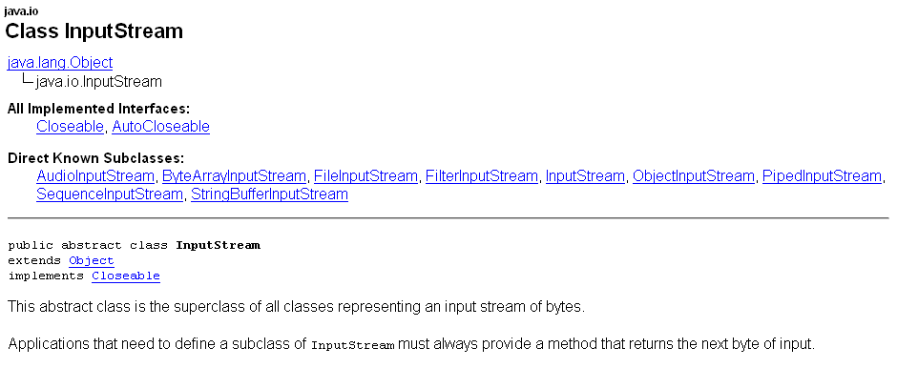

Slide 16

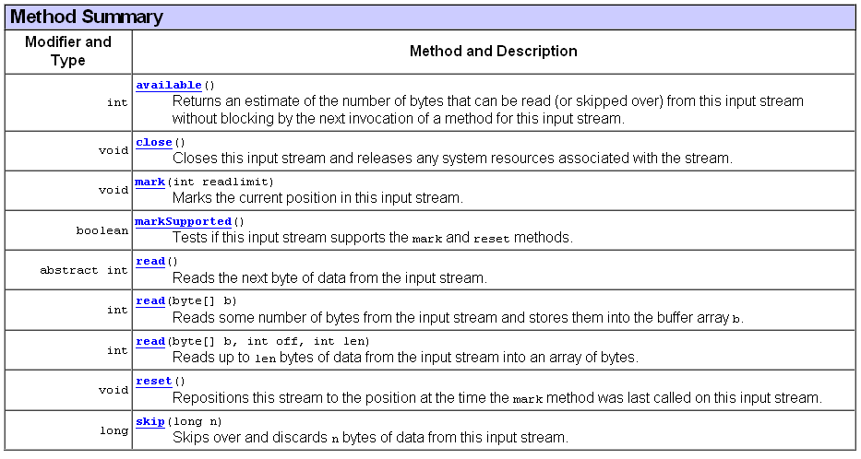

Slide 17
Binary Format
To write:
FileOutputStream outputStream =
new FileOutputStream("output.bin");
Use write method of OutputStream class to write a single byte:
OutputStream out = . . .;
byte b = . . .;
out.write(b);
When you are done writing to the file, you should close it:
out.close();

Slide 18
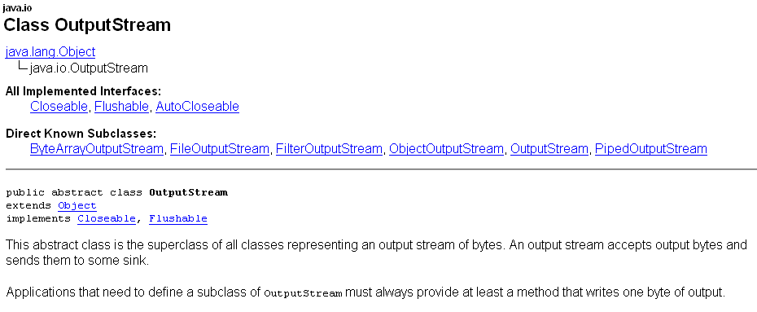

Slide 19

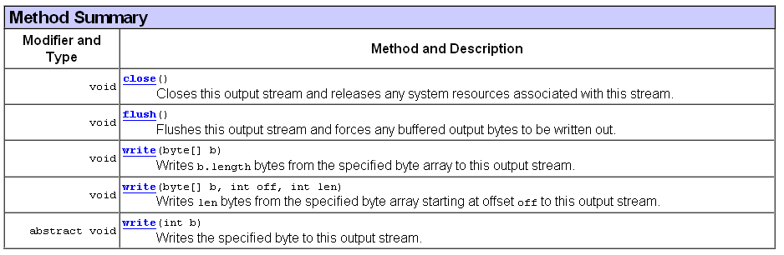

Slide 20
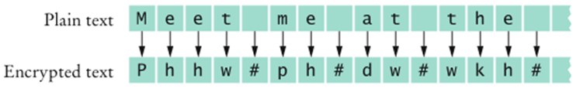
An Encryption Program
File encryption
To scramble it so that it is readable only to those who know the encryption method and secret keyword
To use Caesar cipher
Choose an encryption key – a number between 1 and 25 that indicates the shift to be used in encrypting each byte
Example: If the key is 3, replace A with D, B with E, ...
To decrypt, use the negative of the encryption key

Slide 21
To Encrypt Binary Data
int next = in.read(); if (next == -1) done = true; else { byte b = (byte) next; byte c = encrypt(b); out.write(c); }

Slide 22
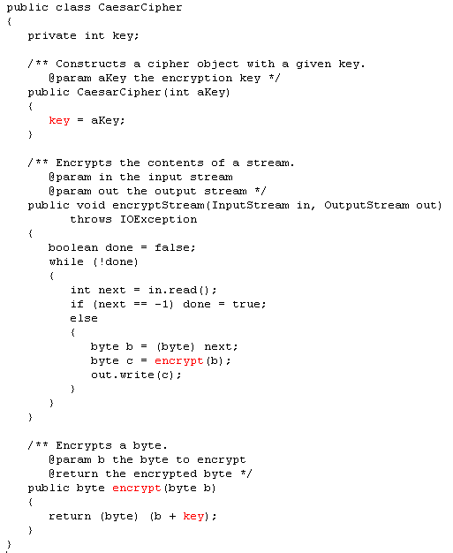

Slide 23
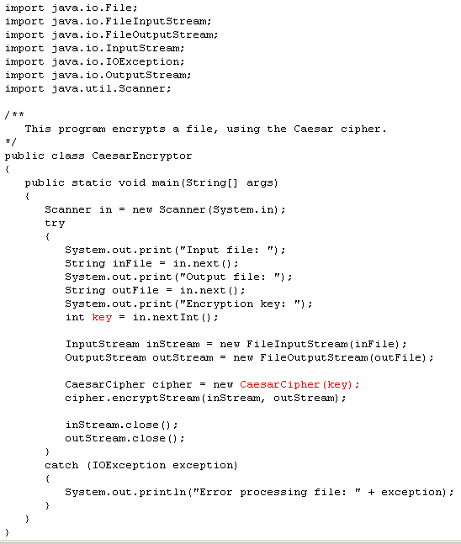

Slide 24
Something to consider
Why does the read method of the InputStream class return an int and not a byte?
Answer: It returns a special value of –1 to indicate that no more input is available. If the return type had been byte, no special value would have been available that is distinguished from a legal data value.

Slide 25
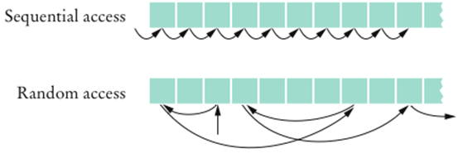
Random Access vs. Sequential Access
Sequential access
A file is processed a byte at a time
It can be inefficient
Random access
Allows access at arbitrary locations in the file
Only disk files support random access
System.in and System.out do not
Each disk file has a special file pointer position
You can read or write at the position where the pointer is

Slide 26
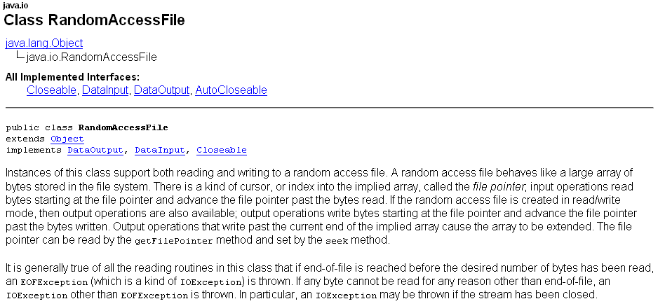

Slide 27
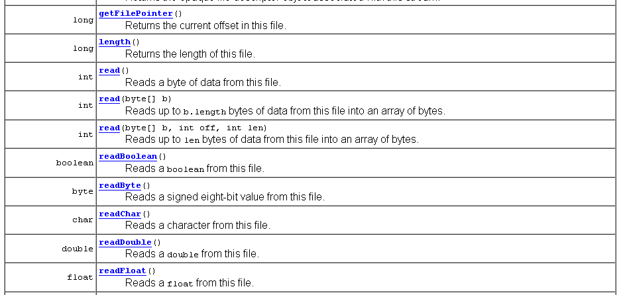
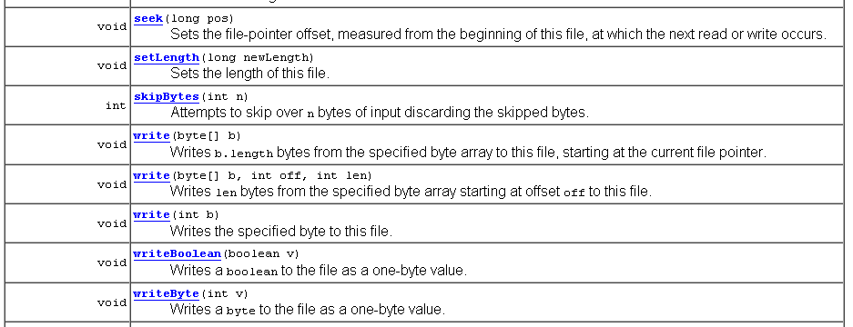

Slide 28
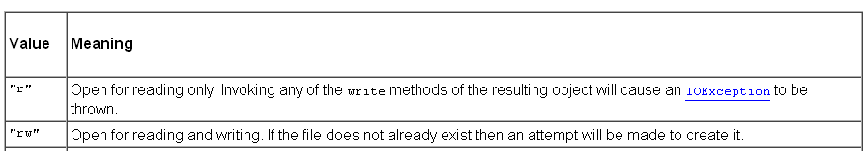
RandomAccessFile
You can open a file either for
Reading only (“r”)
Reading and writing (“rw”)
RandomAccessFile f = new RandomAcessFile("bank.dat","rw");
To move the file pointer to a specific byte:
f.seek(n);
To get the current position of the file pointer:
long n = f.getFilePointer(); // of type "long" because files can be very large
To find the number of bytes in a file:
long fileLength = f.length();

Slide 29



A Sample Program
Use a random access file to store a set of bank accounts
Program lets you pick an account and deposit money into it
To manipulate a data set in a file, pay special attention to data formatting
Suppose we store the data as text
Say account 1001 has a balance of $900, and account 1015 has a balance of 0
We want to deposit $100 into account 1001
If we now simply write out the new value, the result is

Slide 30
A Sample Program
Better way to manipulate a data set in a file:
Give each value a fixed size that is sufficiently large
Every record has the same size
Easy to skip quickly to a given record
To store numbers, it is easier to store them in binary format

Slide 31
A Sample Program
RandomAccessFile class stores binary data
readInt and writeInt read/write integers as four-byte quantities

Slide 32
A Sample Program
readDouble and writeDouble use 8 bytes:
double x = f.readDouble();
f.writeDouble(x);
To find out how many bank accounts are in the file:
public int size() throws IOException { return (int) (file.length() / RECORD_SIZE); // RECORD_SIZE is 12 bytes: // 4 bytes for the account number and // 8 bytes for the balance }

Slide 33
A Sample Program
To read the n^{th} account in the file (n is the index):
public BankAccount read(int n) throws IOException {
// move file pointer to correct position file.seek(n * RECORD_SIZE);
// read in accountNumber int accountNumber = file.readInt();
// read in balance double balance = file.readDouble();
// create a new BankAccount using this data return new BankAccount(accountNumber, balance); }

Slide 34
A Sample Program
To write the n^{th} account in the file (n is the index):
public void write(int n, BankAccount account) throws IOException {
//move file pointer to correct position file.seek(n * RECORD_SIZE);
// write the account number file.writeInt(account.getAccountNumber());
// write the balance file.writeDouble(account.getBalance()); }

Slide 35
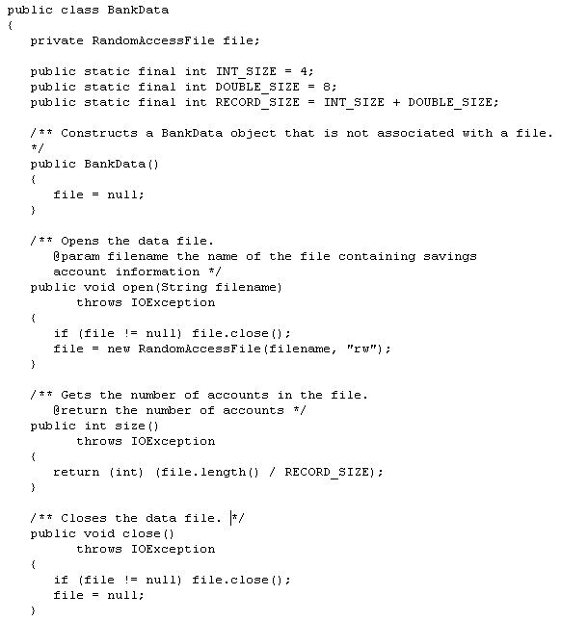

Slide 36
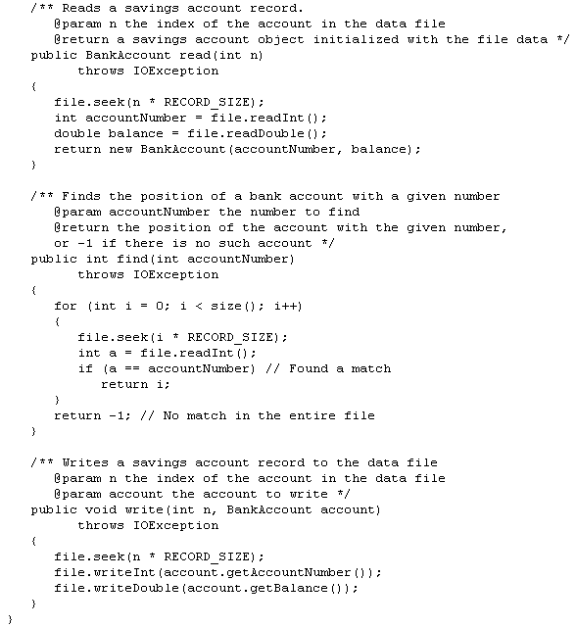

Slide 37
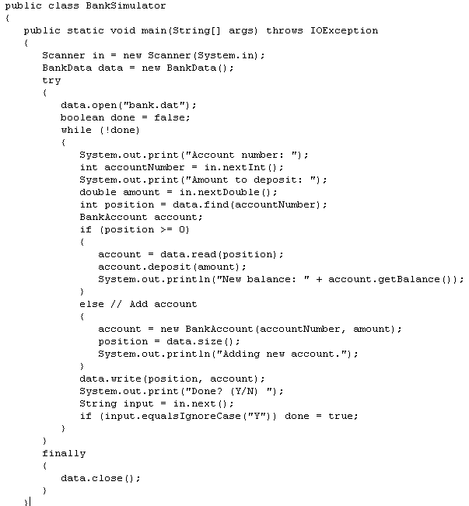

Slide 38
Something to consider
What is the advantage of the binary format for storing numbers? What is the disadvantage?
Answer: Advantage: The numbers use a fixed amount of storage space, making it possible to change their values without affecting surrounding data. Disadvantage: You cannot read a binary file with a text editor.

Slide 39
Object Streams
ObjectOutputStream class can save an entire objects to disk
ObjectInputStream class can read objects back in from disk
Objects are saved in binary format; hence, you use streams

Slide 40
Writing a BankAccount Object to a File
The object output stream saves all instance variables:
BankAccount b = ...; ObjectOutputStream out =
new ObjectOutputStream(new FileOutputStream("bank.dat"));
out.writeObject(b);

Slide 41
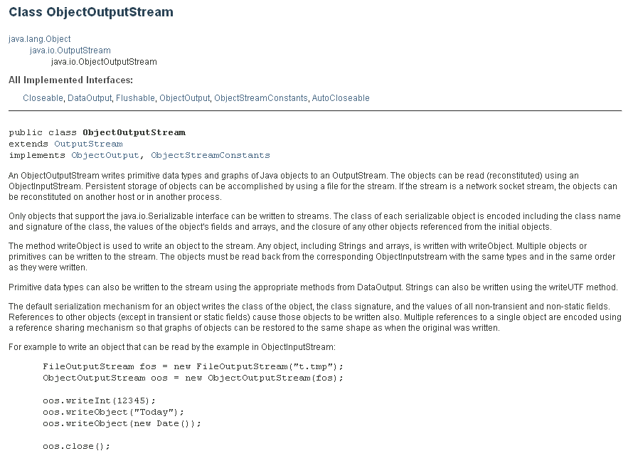

Slide 42
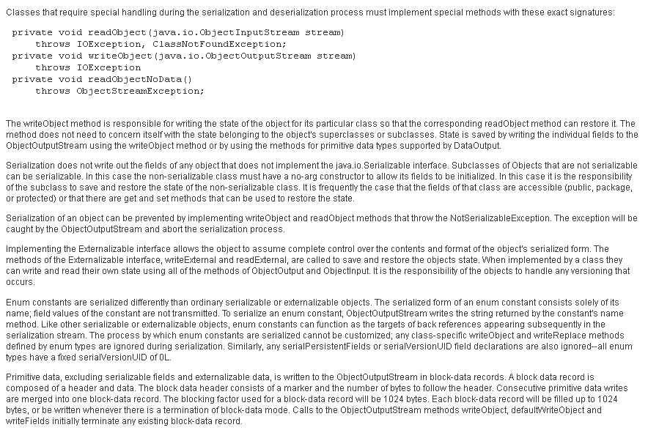

Slide 43
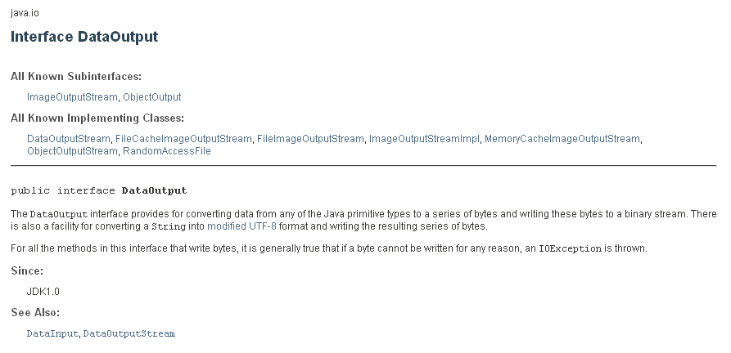

Slide 44
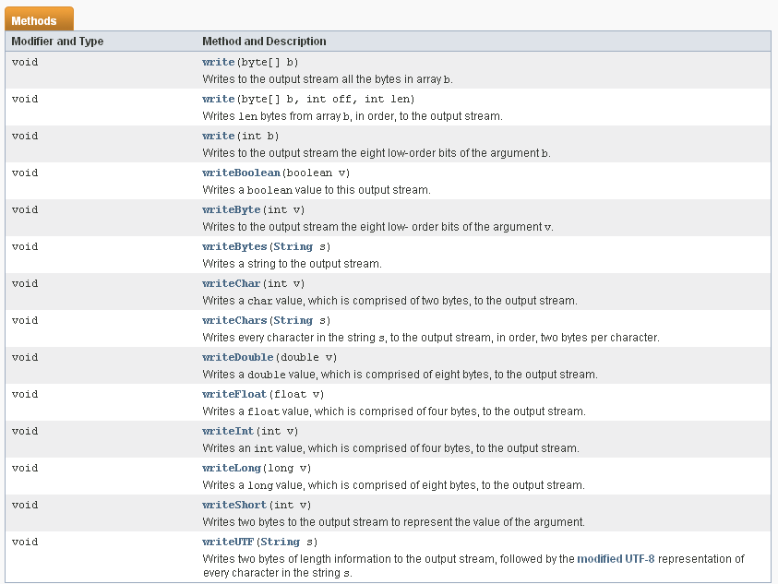
DataOutput Methods

Slide 45
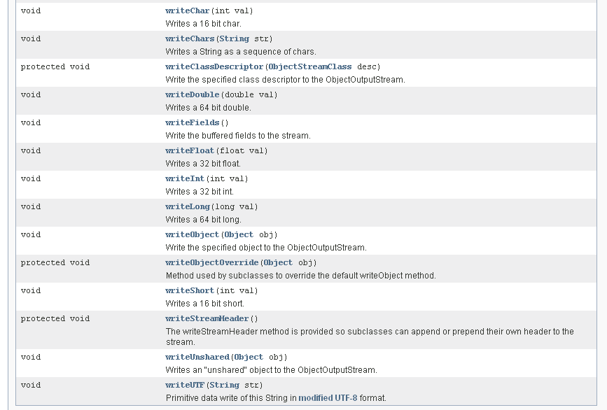
ObjectOutputStream methods

Slide 46
Reading a BankAccount Object from a File
readObject returns an Object reference
Need to remember the types of the objects that you saved and use a cast:
ObjectInputStream in = new ObjectInputStream(new
FileInputStream("bank.dat"));
BankAccount b =(BankAccount) in.readObject();
readObject method can throw a ClassNotFoundException
It is a checked exception - you must catch or declare it

Slide 47
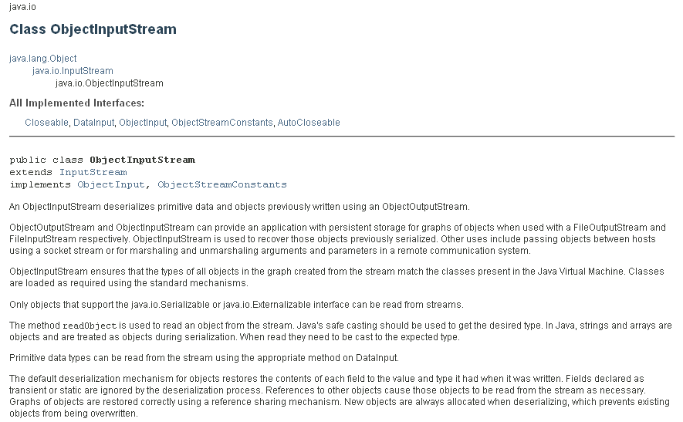
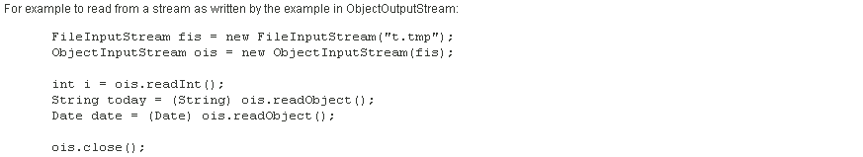

Slide 48
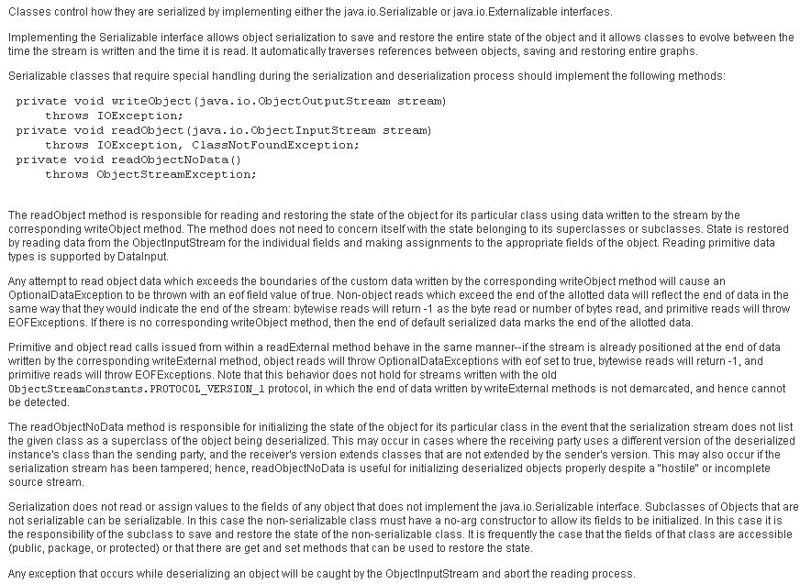

Slide 49
Write and Read an ArrayList to a File
Write:
ArrayList<BankAccount> a = new ArrayList<BankAccount>();
// Now add many BankAccount objects into a file
out.writeObject(a);
Read:
ArrayList<BankAccount> a =
(ArrayList<BankAccount>) in.readObject();

Slide 50
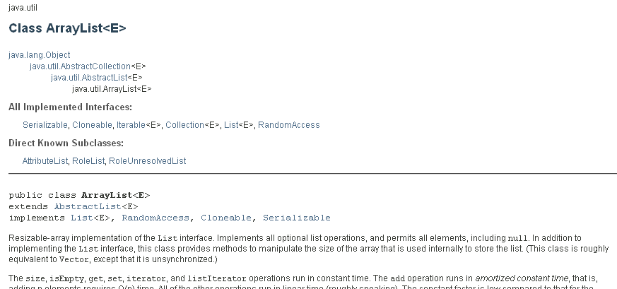

Slide 51
Serializable
Objects that are written to an object stream must belong to a class that implements the Serializable interface:
class BankAccount implements Serializable { ... }
Serializable interface has no methods
Serialization: Process of saving objects to a stream
Each object is assigned a serial number on the stream
If the same object is saved twice, only serial number is written out the second time
When reading, duplicate serial numbers are restored as references to the same object

Slide 52
Serializable
All Collection classes in the Java Collections Framework implement the Serializable Interface.
Provides information to the Java virtual machine about sending instances of the class to/from a stream (a sequence of bytes)
Any class that implements Serializable will be able to copy any object of the class to an output stream – that is to “serialize” the elements in the object.
“Deserialization” reconstructs the original object from a stream.
Provides a writeObject method
This is the writeObject for the ArrayList class:
private void writeObject(ObjectOutputStream s) throws IOException
{
// Write out element count (size of ArrayList)
s.defaultWriteObject();
// Write out array length (which holds the elements – elementData)
s.writeInt (elementData.length)
//Write out all elements in the proper order
for(int i=0; i<size; i++)
s.writeObject(elementData[i]);
}

Slide 53
You have created an ArrayList called names whose elements are of type String. Write names to a binary file using ObjectOutputStream
try
{
ObjectOutputStream oos = new ObjectOutputStream(new FileOutputStream(“names.bin”);
oos.writeObject(names);
}
catch (IOException e)
{
System.out.println(e);
}
Read from the file back into an ArrayList:
try
{
ObjectInputStream ois = new ObjectInputStream(new FileInputStream(“names.bin”);
names = (ArrayList<String>)ois.readObject();
}
catch (IOException e)
{
System.out.println(e);
}

Slide 54
Serializable
To make your own classes serializable:
Implement Serializable
If all that is saved is fields, you don’t need to define the writeObject and readObject methods, if more complex, you must define these methods (such as traversing a tree).

Slide 55
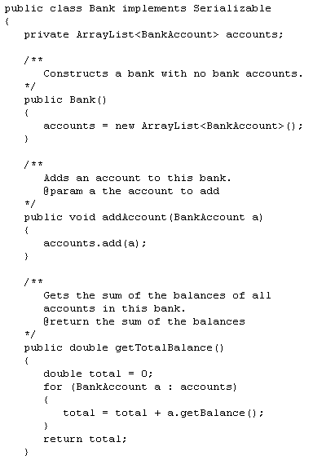
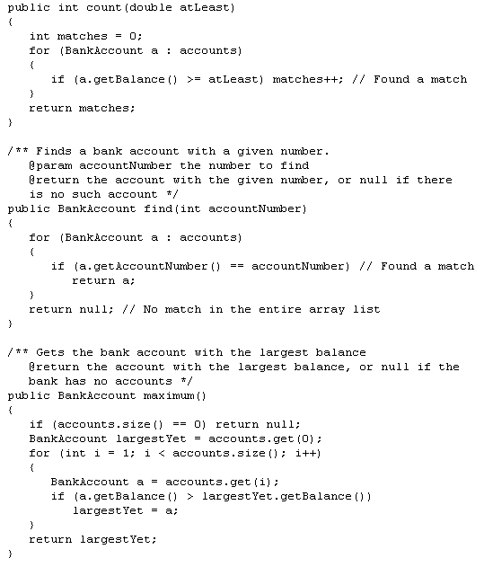
No readObject or writeObject required because ArrayList already has these defined

Slide 56
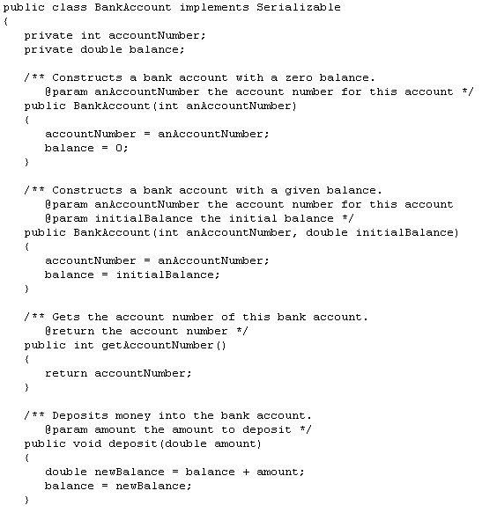
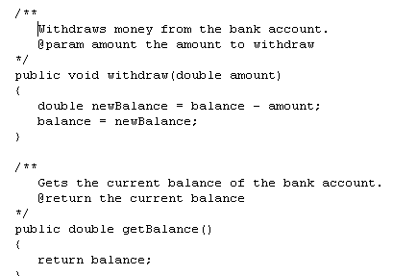
No readObject or writeObject required because only fields
(data members of serializable data types) being saved

Slide 57
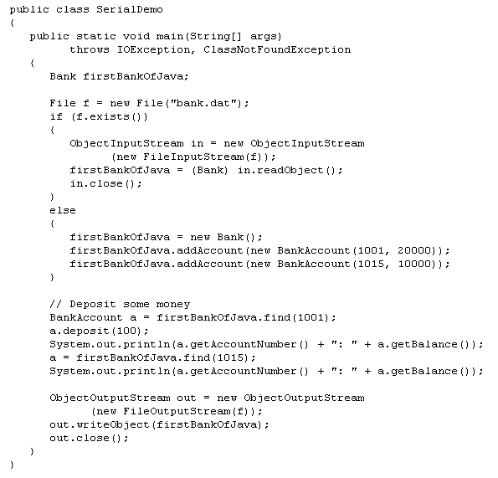

Slide 58
Why is it easier to save an object with an ObjectOutputStream than a RandomAccessFile?
Answer: You can save the entire object with a single writeObject call. With a RandomAccessFile, you have to save each instance variable separately.

Slide 59
Serializing Binary Trees
What data does a tree object hold?
A
B
C
D
E
F
G

Slide 60
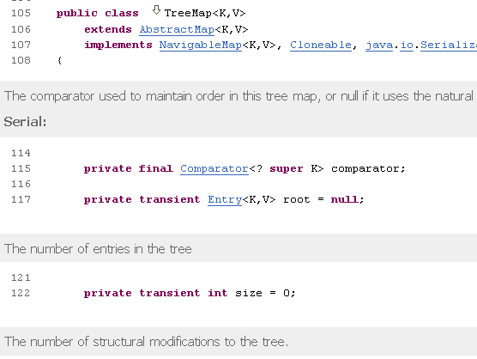

Slide 61
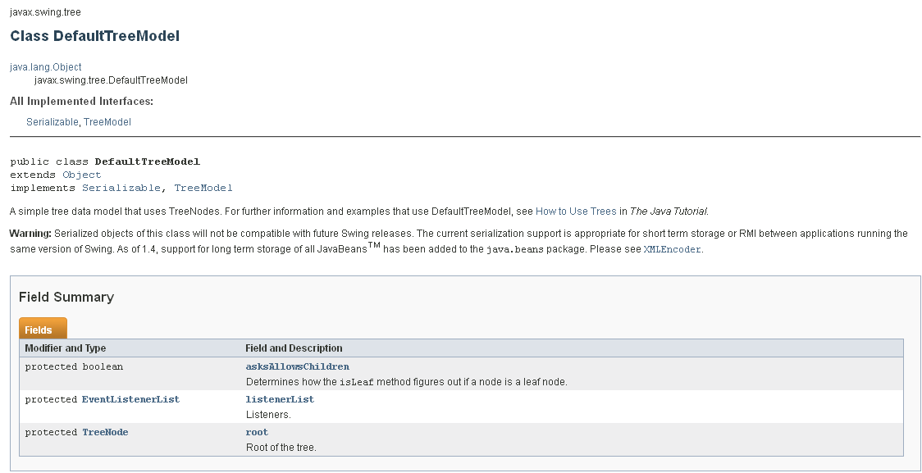

Slide 62
We didn’t need a readObject or writeObject because only fields
were being saved (enough information to reconstitute the BankAccount object)

Slide 63
Storing just the fields (root) will not give us all the information needed to reconstitute the tree – therefore must provide a definition for the writeObject and readObject methods which determines how to serialize and deserialize the tree.

Slide 64
Serializing Binary Trees
Print a tree to a file, saving structure information
First Try: Print out nodes, in order that they would
appear in a PREORDER traversal.
Why doesn’t this work?
A
B
C
D
E
F
G
A B D E G C F

Slide 65
Serializing Binary Trees
Printing out nodes, in order that they would appear in a
PREORDER traversal does not work, because we don’t
know when we’ve hit a null pointer
Store null pointers, too!
A
B
C
D
E
F
G
A B D / /E G / / / C / F / /

Slide 66
Serializing Binary Trees
What would the tree look like with this representation?
ABDE//G///CF/H///
A
B
C
D
F
E
G
H

Slide 67
ABDE//G///CF/H///
1A1B1D1E001G0001C1F01H000
Read an int
If a 1 then data follows it, read the data
If a 0, represents a null

Slide 68
private void writeObject(ObjectOutputStream out) throws IOException
{
if (root != null)
tree_FileWrite(root, out);
}
private void tree_FileWrite(Node r, ObjectOutputStream out)throws IOException
{
if(r != null)
{
//recursive function that uses preorder to write the data of the nodes to the file
// first write out the data of this node
out.writeInt(1); // means a node will follow
out.writeObject(r.data); // String implements serializable
// then write out nodes to the left and then nodes to the right
tree_FileWrite(r.left,out);
tree_FileWrite(r.right,out);
}
else out.writeInt(0);// this will represent a null in the tree
}

Slide 69
private void readObject(java.io.ObjectInputStream in)throws IOException, ClassNotFoundException
{
root = new Node();
tree_FileRead(root, in);
}
private Node tree_FileRead(Node r, ObjectInputStream in)throws IOException, ClassNotFoundException
{
int n = in.readInt();
if(n != 0)
{
if(r != root)
r = new Node();
r.data = (String)in.readObject();
r.left = tree_FileRead(r.left,in);
r.right = tree_FileRead(r.right,in);
}
else r = null;
return r;
}

